Slide 1
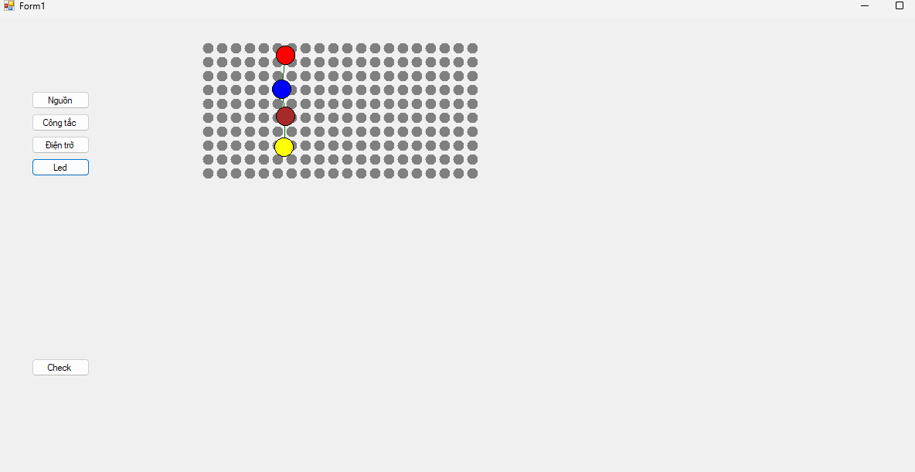
Nguồn => công tắc => điện trở=> led
Click vào linh kiện và nối dây

Slide 2
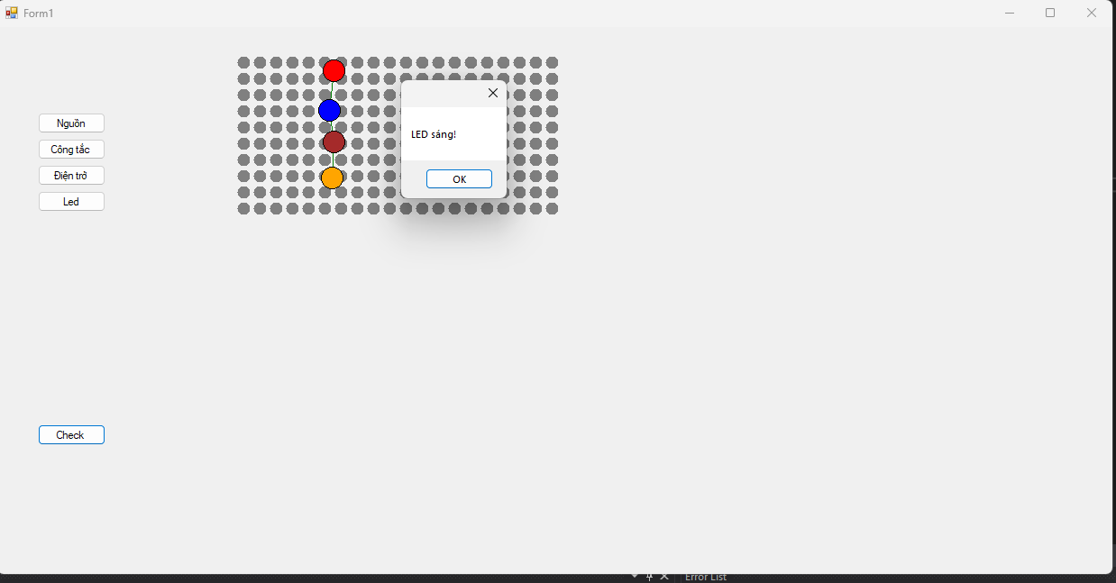

Slide 3
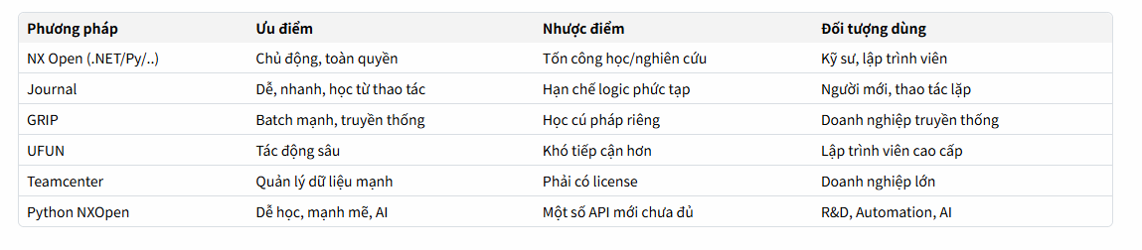
Lời khuyên thực tế
  Nếu bạn phát triển dự án công nghiệp/automation:
  NX Open C#, Python, hoặc Java là mạnh nhất.
  Nếu lặp lại thao tác đơn giản: Journal.
  Nếu cần UI tuỳ chỉnh: NX Open + UI Styler.
  Nếu xử lý dữ liệu lớn, batch process: Python hoặc Batch Script + Journal.

Slide 4
Part
Assembly
Communication
Thay đổi parameter ( 1 tham số)
Thay đổi tham số parameter(list parameter)
Lấy tên các feature
Suppres/unsuppress feature
Change color
Change material
Thay đổi parameter ( 1 tham số)
Thay đổi tham số parameter(list parameter)
Lấy tên các part
Suppres/unsuppress part
Visible part in choose
Change parameter simulation.
Update change
Change color assembly
Connect CNC machine serial port
Wireless connect CNC machine
Send file G-code , X-Code
General
Check open software
Check open part/assembly/drawing
Export PDF
Create QR code with part/Assembly.
Open Part
Open Assembly
Open part(run hide)
Open Assembly (run hide).
Open software(run hide).
Set view
Create a platform
Advanced
List components in Assembly=> estimate manufacturing cost.
Scan QR in drawing to show position in3d model.

Slide 5
1.NX Open Concepts & Architecture
2. Positions, Vectors, and Points
3. Working with Curves
Sessions and Parts
Objects and Tags
Factory Objects
Object Collections
The Builder Pattern
Exploring NX Open Using Journaling
Point3d Objects
Vector3d Objects
Smart Points
Lines
Associative Line Features
Arcs and Circles
Associative Arc Features
Conic Section Curves
Studio Splines
Sketches
5. Object Properties & Methods
NX Object Properties
Curve and Edge Properties
Face Properties
4. Simple Solids and Sheet Bodies
7. Assemblies
Creating Primitive Solids
Creating Sections
Extruded Bodies
Revolved Bodies
Introduction to NX Assemblies
The Obligatory Car Example (Understanding Practical Use)
Trees, Roots, and Leaves (Assembly Structure)
Components and Prototypes
Cycling Through an Assembly
Indented Listings in Assemblies
Component Positions & Orientations
Object Occurrences and Context
Creating and Managing Assemblies
Changing Reference Sets
Additional Advanced Topics in Assemblies
9. Selecting NX Objects
Using Selection Dialogs
Working with Select Object Blocks
Selecting Faces, Curves, and Edges Using Collectors
8. Drawings & Annotations
Introduction to Drawing Automation in NX
Sheets & Sheet Properties
Views & View Properties
  Base Views
  Projected Views
  Using the View Wizard
Dimensioning:
  Linear
  Radial
  Angular
GD&T (Geometric Dimensioning and Tolerancing)
Adding Notes and Labels
Automating Title Blocks
10. Block UI Styler
When to Use Block-Based Dialogs
How Block-Based Dialogs Work
The Overall Process of Dialog-Based Interfaces
Using Block UI Styler Effectively
Working with Controls, Groups, and Properties
Getting Integer, Double, and String Input from Users
Receiving Point3d and Vector3d Inputs in Dialogs
Selecting Bodies, Faces, and Edges Through Dialog
Handling Events: initialize, apply, okay, and update

Slide 6
11. Using Remote Applications
12. Exception Handling in NX Open
13. Troubleshooting NX Open Development
Client-Side Programming Concepts
Server-Side Programming in NX Open
Executing Commands on Remote NX Systems
Understanding Exceptions in C# and NX
Examples of Unhandled Exceptions
Properly Handling Exceptions
Accessing Exception Properties
Working with NX-Specific Exceptions
Strategies to Avoid Exceptions
The Role of the finally Block
Reading and Using the NX Log File
Solving “Invalid Attempt to Load Library” Errors
Resolving “is not a member of NX Open” Issues
Fixing “Unable to Load Referenced Library” Errors
Dealing with “Failed to Load Image” Problems
14. Post-Training Support
Real-World Project Support and Guidance
Resume Building & Interview Preparation
Job Assistance & Long-Term Career Guidance

Slide 7
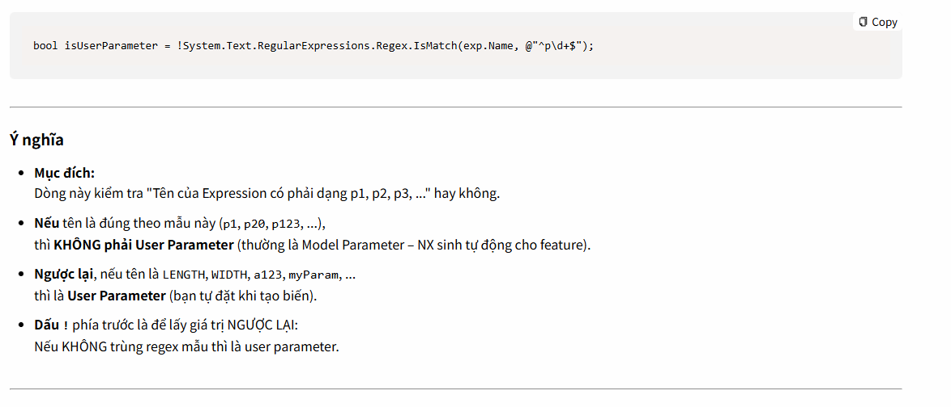
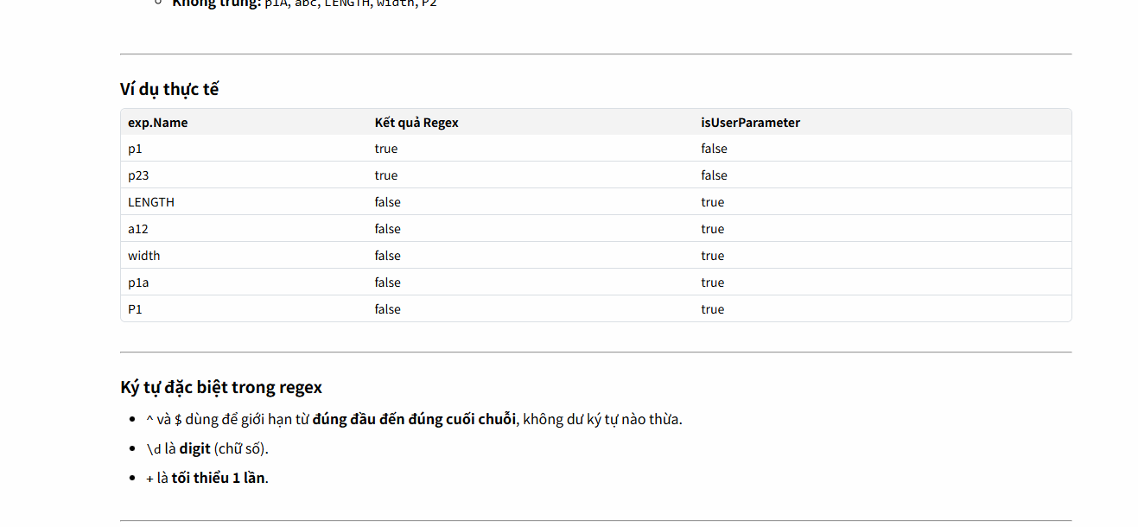
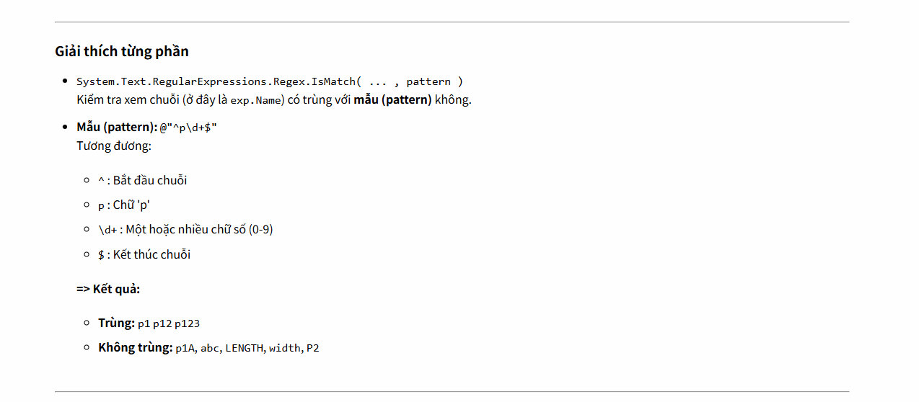

Slide 8
